Slide 1
NumPy in Python

Slide 2

NumPY
The NumPy (Numeric Python) package required for high performance computing and data analysis.
Overcomes the problem of running slower algorithms on Python by using multidimensional arrays and functions that operate on arrays.
Allows concise and quick computations by VECTORIZATION.
To use NumPy module, we need to import it using:

Slide 3
Advantages of using NumPy with Python
Array oriented computing
Efficiently implemented multi-dimensional arrays
Designed for scientific computation
Standard mathematical functions for fast operations on entire arrays of data without having to write loops
Tools for reading / writing array data to disk and working with memory-mapped files
Linear algebra, random number generation, and Fourier transform capabilities

Slide 4
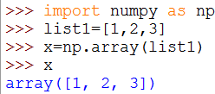

NumPy(Array)
NumPy array is a grid of values.
Similar to lists, except that every element of an array must be the same type.
Alias for NumPy library is np.
np.array() is used to convert a list into a NumPy array.

Slide 5
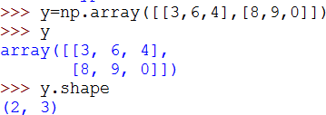
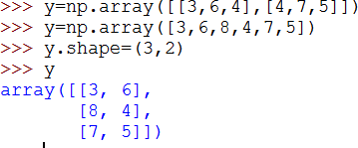
NumPy(Array)
SHAPE
Shape function gives a tuple of array dimensions and can be used to change the
dimensions of an array.
Using shape to get array dimensions
Using shape to change array dimensions

Slide 6
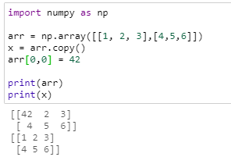
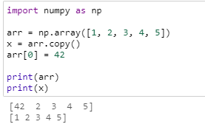
NumPy(Array)
COPY
The copy owns the data and any changes made to the copy will not affect original array, and any changes made to the original array will not affect the copy.

Slide 7
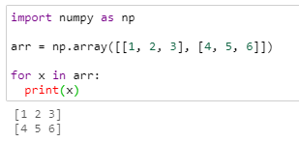
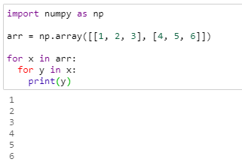
NumPy(Array)
ITERATION
As we deal with multi-dimensional arrays in NumPy, we can do this using basic for loop of python

Slide 8
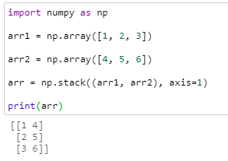
NumPy(Array)
STACK
Stacking is same as concatenation, the only difference is that stacking is done along a new axis.

Slide 9
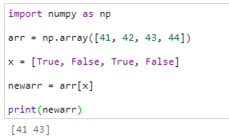
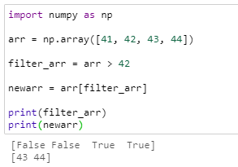
NumPy(Array)
FILTER
If the value at an index is True that element is contained in the filtered array, if the value at that index is False that element is excluded from the filtered array.

Slide 10
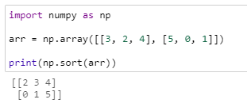
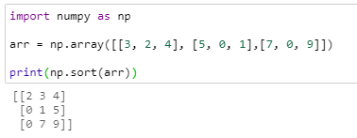
NumPy(Array)
SORT
Sorting means putting elements in a ordered sequence.
Ordered sequence is any sequence that has an order corresponding to elements, like numeric or alphabetical, ascending or descending.
The NumPy ndarray object has a function called sort(), that will sort a specified array.

Slide 11
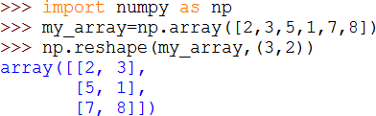
NumPy(Array)
RESHAPE
Gives a new shape to an array without changing its data.
Creates a new array and does not modify the original array itself.

Slide 12
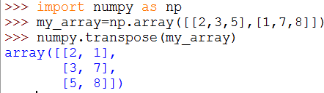
NumPy(Array)
TRANSPOSE
Generates the transposition of an array using the function np.transpose.
Does not affect the original array, but it will create a new array.

Slide 13

NumPy(Array)
FLATTEN
Flatten creates a copy of the input array flattened to one dimension.

Slide 14
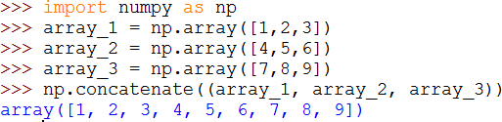
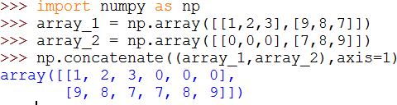
NumPy(Array)
CONCATENATE
Two or more arrays can be concatenated together using the concatenate function with a
tuple of the arrays to be joined:
If an array has more than one dimension, it is possible to specify the axis along which multiple arrays are concatenated. By default, it is along the first dimension.

Slide 15
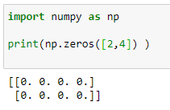
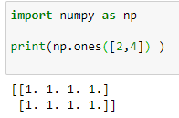
NumPy(Array)
ZEROS
The zeros tool returns a new array with a given shape and type filled with 0's.
ONES
The ones tool returns a new array with a given shape and type filled with 1's.

Slide 16
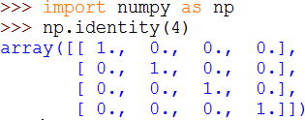
NumPy(Array)
IDENTITY
Returns an identity array.
An identity array is a square matrix with all the main diagonal elements as 1 and the rest
as 0 . The default type of elements is float.

Slide 17
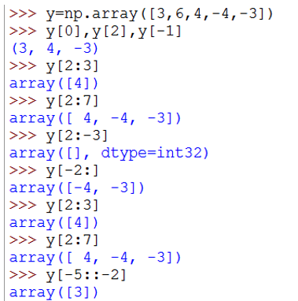





NumPy(Indexing/Slicing)
Fetches elements from 2nd to 7th position of single dimensional array.
Fetches last 2 elements of single dimensional array.

Slide 18
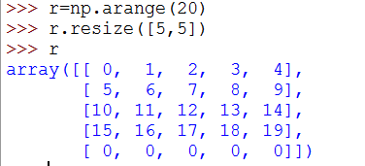
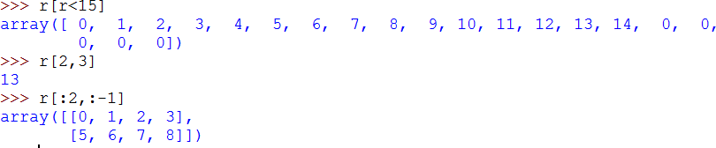
NumPy(Indexing/Slicing)

Slide 19
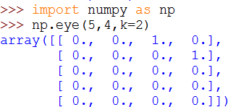
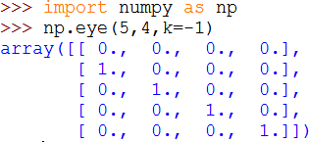
NumPy(Array)
EYE
Returns a 2-D array with 1's as the diagonal and 0's elsewhere.
The diagonal can be main, upper or lower depending on the optional parameter .
Positive k is for the upper diagonal, a negative k is for the lower, and a 0k (default) is for the main diagonal.

Slide 20
NumPy(Linear Algebra)
The NumPy module also comes with a number of built-in routines for linear algebra
calculations.
These can be found in the sub-module linalg.
Some of the built in routines are:
linalg.det
linalg.eiv
linalg.inv

Slide 21
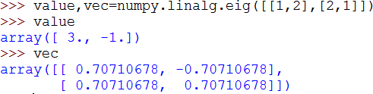
NUMPY(LINEAR ALGEBRA)
linalg.det: Computes the determinant of an array.
linalg.eig: Computes the eigen values and right eigen vectors of a square array.

Slide 22
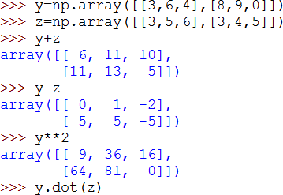





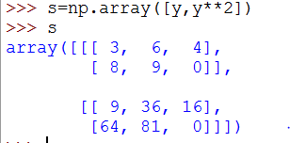
Operations On NumPy
We can perform operations on numpy such as addition, subtraction , multiplication and even dot product of two or more matrices

Slide 23
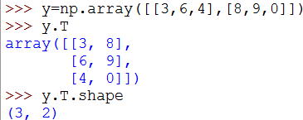








Operations On NumPy
TRANPOSE
To transpose a matrix, use
matrix_name.T operation .
To find what shape is of transposed matrix is use matrix_name.T.shape to find it.

Slide 24
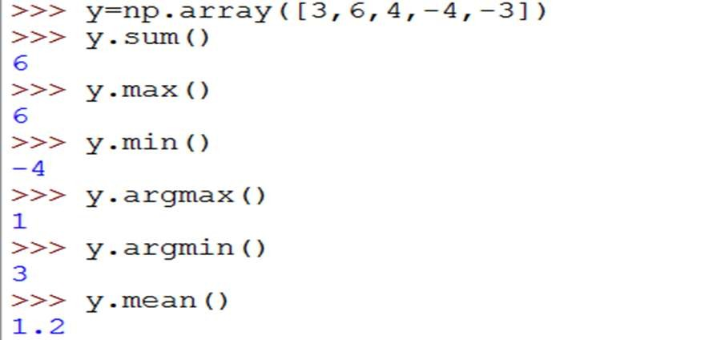



















Operations On NumPy
We can find the sum of matrices by
sum() operation.
We can find the maximum number in the matrix by using max() operation.
We can find the position of the element in the matrix where the maximum or minimum value is in place.
We can find the mean of a matrix using mean() operation.

